Slide 1
Team Cardinals
Group Members: Dylan Sirna, Zhuoxing Wang, Efren Portugal, Gabriel Rodriguez

Slide 2
Project Plan
Scope
Schedule and Work Breakdown Structure
Milestones
Gantt Chart
Team Roles
Technical Description
Data Management Plan
Test Plan

Slide 3
Scope
1. Set up new customers
Keep a record of new and old customers
Information will be keyed by customer phone number
Master record for each customer contains their name, address, phone, and type of charge account (Visa / Mastercard)
Record pertinent information for locating the address (i.e., subdivision name, closest major intersection, etc.)
2. Take pizza orders
For already established customers their address and delivery information should show up
3. Calculate bills
Print out a receipt of the order with a place to sign the form by the customer if it is on a credit card
Checkout cart with customer information, a list of items ordered, if it is for delivery or pickup, and total amount due

Slide 4
Scope Cont.…
4. Process payments
Process payments in the form of checks, cash, or credit cards
Keep track of the type of payment made and amount
5. Contain restaurant menu
A GUI interface for the user that shows the complete restaurants menu for order-taking purposes
The menu will have different options for the customer to order customized pizzas
They can choose the pizza’s size, crust, and toppings
Order other menu items like beverages and choose the number of pizzas they want
The menu GUI interface will utilize dropdown and radio/checkbox buttons for customizing pizzas

Slide 5
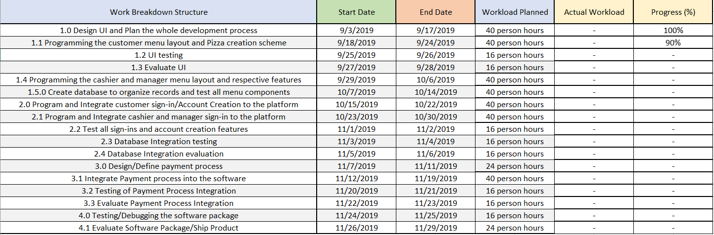
Schedule and Work Breakdown Structure

Slide 6
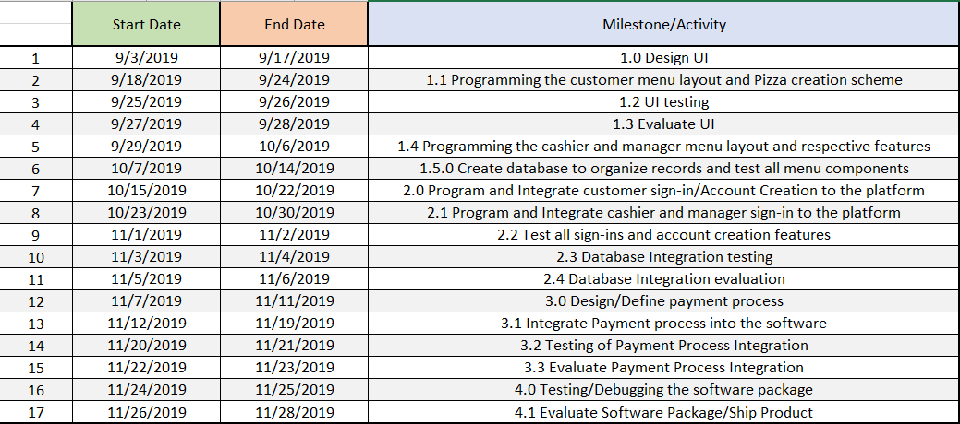
Milestones

Slide 7
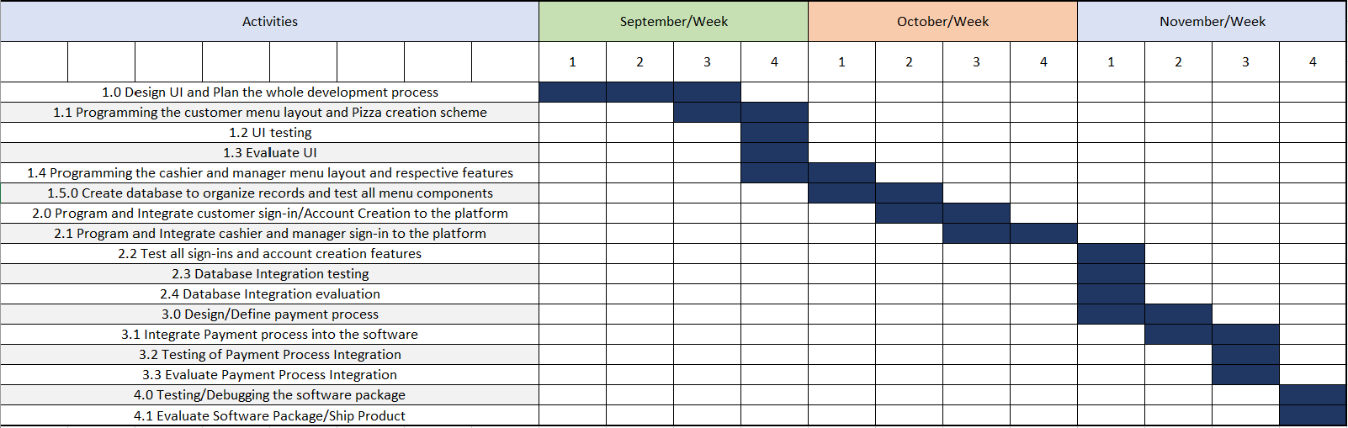
Gantt Chart

Slide 8
Team Roles
Dylan Sirna - Team Leader, Project Manager, Tester, Programmer
Gabriel Rodriguez - Lead Programmer, Lead Designer, Tester
Efren Portugal - Lead Document Writer, File Manager, Programmer, Tester
Zhuoxing Wang – Organizer, Programmer, Tester, Technical and Graph Provider

Slide 9
Technical Description
The system consists of two modules. The first module is the customer module, which enables the users to create an account, login, edit their information, and make any order they want. The second module is the manager module, which enables the manager to edit menu prices and generate reports.
Module 1 – Customer Module Components:
Customer Login: In this screen the customer can login with their account or as guest and create an account if they are not registered yet.
Customer Logged-In Menu: This screen is the main menu of the software for logged-in customers.
Customer Guest Menu: This screen is the main menu of the software for guest customers.

Slide 10
Technical Description Cont.
Customer Logged-In Account Configuration: In this screen users can edit all their information.
Selection Screen: This screen is the main tool for customizing the order in terms of pizza basics, meats, and non-meats. Also, the user will be able to add/remove from Cart the different pizzas.
DS (Drinks, Sides): This screen is the main tool for customizing the order in terms of drinks and sides. Also, the user will be able to add/remove from Cart the drinks and desserts.
Customer Logged-In Confirmation Screen: In this screen the user can see all the items in Cart, the client information, choose between delivery and pickup, and choose a Payment Method (Cash, Card). Also, the user can remove items from the Cart. A receipt will be printed when the order is registered.
Customer Guest Confirmation Screen: Same as the Customer Logged-In Confirmation Screen, but prompts the users to enter required information for the order.

Slide 11
Technical Description Cont.
Module 2 – Manager and Cashier Module Components:
Administration Login: In this screen the managers can login.
Manager Menu: In this screen the manager can generate reports and edit the pizza, drinks, and sides prices on menu.

Slide 12
Data Management Plan
Project: Pizza Order and Delivery System
1. Description of the Data
1.1 Type of Data
Details of all registered users and detailed menu data.
1.2 Details of User’s Data
Username, Name, Address, Phone number, Payment information, and logistic (Pick up/ Delivery).
1.3 Details of Menu Data
Pizza basics (size, crust) meats, non meats, drinks, and sides.
1.3 Format and Scale of Data
For every new user registered in our application, his/her detailed information must generate a registry in the respective database fields. His/her information (include 1.2) must be saved and kept secret.

Slide 13
Data Management Plan Cont.
2. Data Management and Dissemination Management
2.1 Data confidentiality
User's information and data cannot be disclosed. Apart from staff and messengers, the contact information and address of the customer should not be disclosed to others. Only users have the right to check, change, and delete their data especially because of the payment information.
2.2 Application of User’s Data
When the registered user completes the ordering service, according to the user's information, the staff will receive the user's detailed ordering requirements and contact details.
2.3 Application of Menu Data
Real-time updates are required, and all current prices are displayed to users.

Slide 14
Test Plan
The system contains many input fields and selections when registering, login in, customizing the pizza, ordering drinks or sides, and when confirming the purchase. All these fields will be tested to ensure the high quality of each component.
Each member from the development team will contribute to test some components. We will prepare cases for each possible risk and data inputs and preconditions to make each test more specific.
Each case will be tested at least 2 times to ensure that we don’t miss an error by mistake. The person in charge of a certain component is responsible for testing all the required cases of that component and recording the results.
Nevertheless, when merging the different components for a release, we, as a team, will conduct a group testing of all the components together to identify any relationship error.
We will also test if the data is correctly inserted into the database, and how long it would take to search and find information when dealing with a high number of registries.

Slide 15
Test Plan Cont.
The criteria for terminating testing is having 95% of risks tested and resolved and the other 5% not being any deathly or frequent errors.
A sample of the table we will be using to record the results of the test has the following:
Test Scenario: Describes the functionality we are testing.
Test Case: Describes the case we are testing of the functionality.
Pre-Conditions: Describes any prior requirements we assume are met for the functionality to be successful.
Test Data: Describes the data examples that we will use to meet the case we are testing.
Expected Result: Describes what we think will be the outcome of the functionality.
Actual Result: Describes what was the actual outcome of the functionality.
Pass/Fail: Here we specify if the testing case was a success or failure.

Slide 16
Test Plan Cont.

Slide 17
Requirements Document
Requirements Definition
Class Diagram
Use Case Diagram
Class Documentation
Use Case Flow of Events
Entity Relationship Diagram
Decision Tables

Slide 18
Requirements Definition
Functional Requirements:
Customers are able to create an account for the software.
Registered customer can edit their personal and billing information and change and recover password.
Customers are able to login as registered users and as guest users for those who don’t have an account
A cashier is able to login as guest to take orders from clients calling the restaurant to order.
Manager can login, edit prices of size and toppings, and drinks and sides. Manager can also generate reports of daily, monthly transactions.
Customers are able to fully customize the size, crusts, and toppings of the pizza.
The price is based on the size of the pizza and the extra toppings. The application shows a detailed menu with the following pricing rules:
Sizes: Small ($4), Medium ($6), Large ($8), Extra-large ($10).
Crusts: Thin, Regular, Pan.
First topping free. Prices for additional toppings:
For a Small pizza: $0.50 per extra topping.
For a Medium pizza: $0.75 per extra topping.
For a Large pizza: $1.00 per extra topping.
For an Extra-large pizza: $1.25 per extra topping.
After ordering pizza, customer can choose to go to the drinks and sides screen or go directly to the order confirmation screen. If customer goes to drinks and sides order interface, the system will show the price of sides and drinks, and they will be able to select everything they want.
Drinks (pepsi) small medium and large all 1$
Garlic Bread sticks – 2$
Bread sticks bites -2$
Big chocolate chip cookie -4$
When finishing all customization of pizzas, drinks or sides, the customer will be able to review their order in the account confirmation screen. There they will select the payment method and the logistics of the order (Delivery or Pickup). There’s no dining at the restaurant. The system must have three different payment methods: Cash, Card, and Check.
Finally, when confirming the order the software will register the transaction information in the database ad print a receipt of the order.

Slide 19
Requirements Definition Cont.
Non-Functional Requirements:
Only manager can edit price of the goods and generate reports of transactions.
Only the customer can edit his/her account information and order details.
It is better to maintain the system once a week, the maintenance time is non-business time, and the maintenance time should not exceed 2 hours.
This application should be focused on being a desktop app. Possible compatibility with tablets may be needed.
When users operate the application, the response time of the program should be as short as possible, preferably not more than two seconds.
The software’s interface should provide the users with useful shortcuts to improve the task finishing time.
Software must be reliable and have a 95% error proof probability.
Any crashes in the application should be fixed by the support or maintainability personnel in a short time frame.
Include help dialogs to help customers to better understand the interface and speed up task finishing time.
The application size should not exceed 150MB.The lower the size the better.
The program needs to do data backups to prevent the loss of user data in the database.

Slide 20
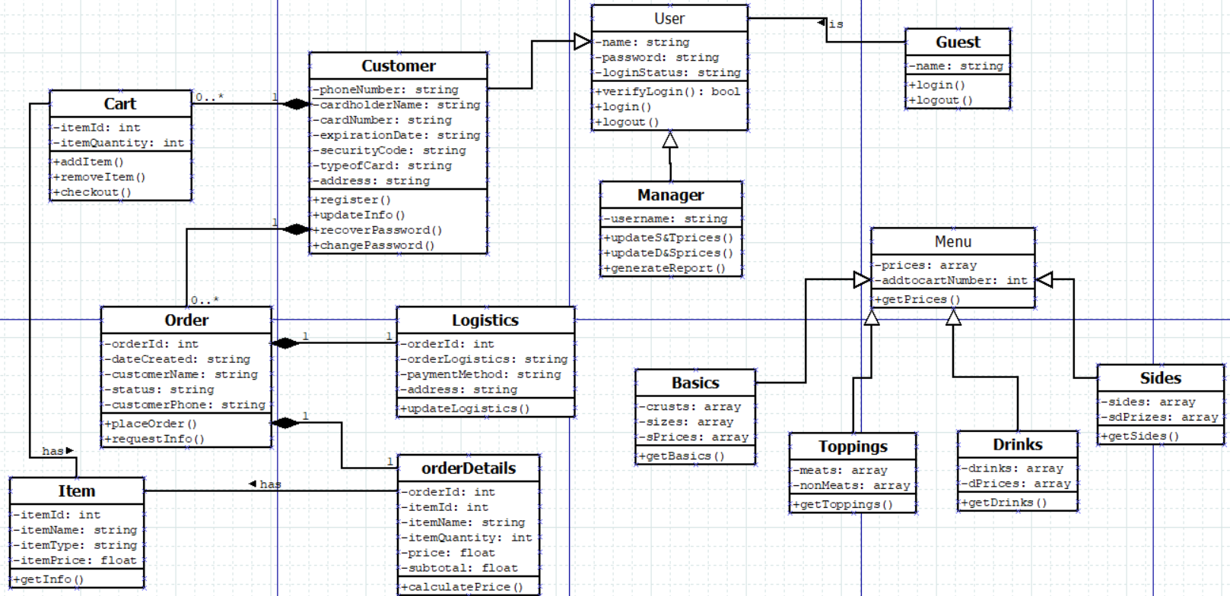
Class Diagram

Slide 21
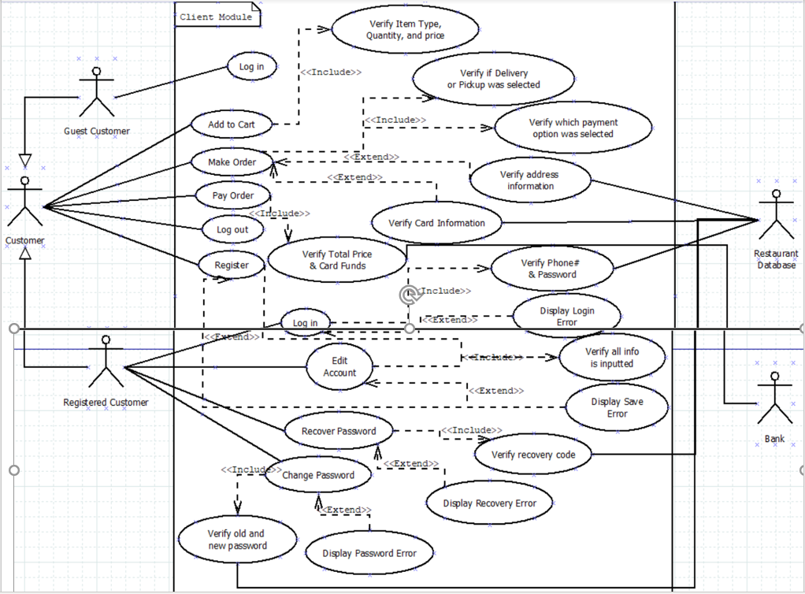
Use Case Diagram

Slide 22
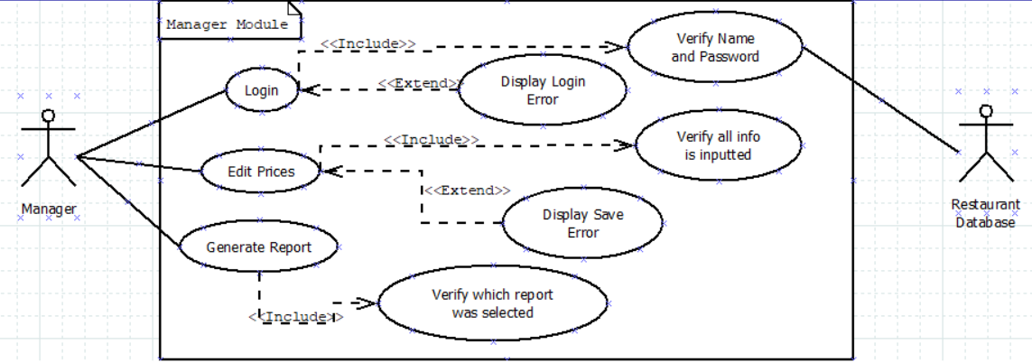
Use Case Diagram Cont.

Slide 23
Class Documentation
Item- This class defines item attributes.
Properties:
itemID: int
itemName: string
itemType: string
itemPrice: float
Methods:
getInfo() – returns values of item properties
Cart – This class facilitates the addition and removal of various items from the menu.
Properties:
-itemID: int
-itemQuantity: int
Methods:
-addItem() -adds item to cart
-removeItem() -removes item from cart
-checkout()-processes card information

Slide 24
Class Documentation Cont.
Order- This class contains the necessary customer and order information to facilitate the ordering system.
Properties:
-orderId: int
-dateCreated: string
-customerName: string
-status: string
-customerPhone: string
Methods:
-placeOrder()-places users order
-requestInfo()- gets orderID(,dateCreated(,customerName,status and
customerPhone values.
Customer - This class defines several user specific attributes to keep track of returning customers.
Properties:
-phoneNumber: string
-cardholderName: string
-expirationDate: string
-securityCode: string
-typeofCard: string
-address: string
Methods:
-register() -creates a new account
-updateInfo() -updates account information
-recoverPassword() – recovers password
-changePassword()- allows user to change their password

Slide 25
Logistics – This class handles order deliver and payment methods.
Properties:
orderId: int
orderLogistics: string
paymentMethod: string
address: string
Methods
updateLogistics() – sets address,paymentMethod, orderLogistics and orderID values.
orderDetails- This class defines several attributes used to identify and categorize orders.
Properties
orderId: int
itemId: int
itemName: string
itemQuantity: int
price: float
subtotal: float
Methods
calculatePrice() – calculates total order price
User- This class defines several user specific attributes to facilitate the login of returning customers.
Properties:
Name: string
Password: string
loginStatus: string
Methods:
verifyLogin(): bool -if true grant access to account if false try again
login() -logs in a returning user
logout() -logs out a returning user

Slide 26
Guest – This class is used to process a non-registered user.
Properties:
Name: string
Methods:
Login() – logs in a guest user
Logout()- logs out a guest user
Manager – This class contains several utilities required for management use.
Properties:
Username: string
Methods:
updateS&Tprices() -updates size and topping prices
updateD&Sprices() – updates drinks and sides prices
generateReport() – generates a report
Menu – This class purpose is to display food options and their corresponding prices.
Properties:
prices: array
addtocartNumber: int
Methods:
getPrices() – returns the array of prices
Basics – This class contains the building blocks of the product.
Properties:
crusts: array
sizes: array
sPrices: array
Methods:
getBasics() – gets the crusts, sizes and sPrices

Slide 27
Toppings- This class defines the add-on available in addition to the base product.
Properties:
meats: array
nonMeats: array
Methods:
getToppings() – gets the array of toppings values
Drinks – This class defines the drinks available along with their corresponding prices.
Properties:
drinks: array
dPrices: array
Methods:
getDrinks() -gets the array of drink values
Sides – This class defines the possible side available as well as pricing information.
Properties:
sides: array
sdPrices: array
Methods:
getSides() -gets the array of sides values

Slide 28
Use Case Flow of Events
Actors
Managers: Users who work for or own Mom & Pop’s Pizza Restaurant they decide the items on the menu, price changes, and can generate reports of any transaction.
Customers: Users who order pizza, pay for order and then have it sent to them.
1.0 Flow of Events for Managers Use Case
1.1 Preconditions
Managers must create a profile before they can make changes to the system. They must create a username and password for their profile.
1.2 Main Flow
The use case begins when the manager logins onto the registration system and enters his/her username and password. The system verifies that the username and password is valid (A-1) and the managers presses the login button and is presented with the Manager Logged-In Menu page (Sizes & Toppings). The system prompts the manager if they want to edit the prices of the menu items available for purchase. They can edit the price of the size of the pizza, which is small, medium, large, and extra-large (S-1). They can also edit the prices of the toppings for each size of pizza (S-2). Once the manager decides on their prices, they can save them using the green save button. If the manager wants to change the prices of the sides and drinks the simply click on the sides & drinks button which will take them to the that corresponding page where they can change the menu prices of the small, medium, and large drinks (S-3) and the bread sticks, bread bites, and cookies(S-4). When the manager is satisfied with their changes, they can save them using the green save button. Finally, on the right-hand side of the page the manager can generate reports for any transactions they want to see. They can generate reports for all transactions (S-5), today’s transactions (S-6), monthly transactions(S-7), and registered clients transactions(S-8). They can select any of those four options and then they press the green generate button and a report will pop up for them on the screen. Once the manager is done making all they changes they want they can logoff by using the logout button.

Slide 29
1.3 Subflows (if applicable)
S-1: Edit prices of “Sizes” of pizza
The system displays the different sizes of pizza the customer can order small, medium, large, and extra-large. Next to the names of the sizes is a field box were the manager can set the dollar amount they want to charge for each size of pizza for example a small is $4.00 but they can change it to $5.00. Managers can not input negative numbers they will receive an error message (A-2).
S-2: Edit prices of “Extra Toppings” of pizza
The systems displays how much extra toppings for each size of pizza will cost. Next to the names of the sizes are field boxes were the manager can change the dollar amount for the extra toppings, going from $0.50 cents for small toppings to $0.75 cents as an example. Managers cannot input negative numbers the system won’t allow them to for safe measure (A-3).
S-3: Edit prices of “Drinks”
After clicking on the button “Sides & Drinks” the systems display the drinks which have three sizes small, medium, and large. Next to the names of the sizes are field boxes were the manager can edit the dollar amount of the drinks. Going from let’s say $1.00 to $2.00 for a small drink. Managers cannot input negative numbers the system won’t allow it. (A-4).
S-4: Edit prices of “Sides”
The system displays the different side orders that customers can purchase like bread sticks, bread bites, and cookies. Next to the name of each of the sides is a field box were the manager can change the dollar amount the restaurant charges for their side items. Negative numbers cannot be entered the in the fields (A-5).
S-5: Generate report for “All transactions”
If the user looks to the right-hand side of the page the system shows the generate reports feature were the managers can select 4 options of reports to generate. The first option being “All transactions” which displays all the transactions for Mom & Pop’s restaurant (from a database) in a report. Once generated the use case can continue.
S-6: Generate report for “Today’s transactions”
Managers chooses “Today’s transactions” as one of the four options. Which will allow the manager to generate a report of the restaurant’s workday transactions.
S-7: Generate report for “Monthly transactions”
If the manager choses this option, they will see the transactions of the restaurant by a monthly basis.
S-8: Generate report for “Registered Customers”
If the manager choses this option a report of all the registered customers in the system will be generated. Customers who have profiles in the system, their data will be seen by the managers.

Slide 30
1.4 Alternative Flows
A-1: An invalid username and password is entered. They systems displays a login error message. User is asked to verify name and password. The user can re-enter username and password or terminate the use case.
A-2: An invalid dollar amount is entered (for example a negative number). The user can re-enter a valid dollar amount or terminate the use case.
A-3: An invalid dollar amount is entered. The user can re-enter a valid dollar amount or terminate the use case.
A-4: An invalid dollar amount is entered. The user can re-enter a valid dollar amount or terminate the use case.
A-5: An invalid dollar amount is entered. The user can re-enter a valid dollar amount or terminate the use case.

Slide 31
2.0 Flow of Events for Customers Use Case
2.1 Preconditions
Customers can sign up and make their own accounts in the system which allows them to save pizza orders and saves their billing, address, and phone information for faster checkout. Guest customers will have to have their name, address, phone and billing information ready to input into the system in order to start ordering pizzas.
2.2 Main Flow
The use case begins when a customer logs on to the registration system which shows a sign-in prompt for registered customers asking for their phone number and password. The system verifies that the password is valid (A-1). It also shows a blue button for guests to login and start their order delivery process. There is a “forgot password” link that allows the customer to recover their password if they forgot it for their account. Then, there is a register for an account link that allows new customers to sign up for Mom & Pop’s Pizza Restaurant.
If the activity selected is login for registered customer, the S-1: registered customer login subflow begins.
If the activity selected is guest login, the S-2: guest login subflow begins.
If the activity selected is “forgot password, recover?”, the S-3: recover password subflow begins.
If the activity selected is “Don’t have an account? Register.”, the S-4: register an account subflow has begun.

Slide 32
2.3 Subflows
S-1: Registered Customer Login
Once the customer inputs their phone number and password the “Customer Logged-In Menu” pops up and from there the systems prompts the user to create a pizza order. From there the “Pizza Customization” page appears, and the user can choose how many pizzas they want, the type of crust, the size of the pizza and the toppings. Once the user is satisfied with their order they can continue to the next page and the system will prompt them if want any sides or drinks with their order. If they say yes it will take them to the “Drinks and Sides” page, if they say no it continues to the order confirmation page. Once their drinks and sides have been selected the systems continues to the order conformation page were the customer is prompted to choose Delivery or Pickup and the payment method cash, card, and pay by check. Once those things have been selected the system will prompt the user if the current payment method and address are correct. If yes, the final prompt will appear confirming that the payment was successful, and your order is out for delivery. If no (A-2) the user can go back and make any necessary changes.
S-2: Guest Customer Login
The system will display the Customer login menu were the user can order a pizza without having to sign up for an account. Once they click on guest it takes them to the “Pizza Customization” page, from there they can order how many pizzas they want, the size, crust, and toppings. Then once they have selected their pizza the system will prompt the user if they want any drinks or sides. If yes it will take them to the “Drinks and Sides” page and from there after the user has selected their drinks and sides, they go to the customer guest order confirmation page. If no, they go straight to the confirmation page. Once there the user will be prompted to input in their name, phone number, address, and billing information. They need to fill in this information in order to continue and once they have done the user can pay for the order. Once payed for a prompt will show up telling the customer thank you for your payment your order will be out for delivery soon. Then the user can exit out of the program and the use case ends (A-3).
S-3: Recover Password
The system will display the customer login menu and if you are a registered customer who forgot their password then click the blue hyperlinked named Recover. The system will display the customer password recovery page where it will prompt the user to enter their phone number associated with their account and then the system will send a code to that phone number. Then the user will receive the code in a text and then they will enter that code in the field box and press continue (A-4). The second prompt will appear that asks for the user to enter a new password and then to re-enter that new password. One that is done the user can save the password and new prompt will appear that says saved successfully. Then the user can continue with the use case.
S-4: Register Account
The system will display the customer login menu and if there is a new customer who wants to make an account, they can click on the blue hyperlink that says Register. When the customer clicks on the hyperlink they go to customer registration page where they can begin making their account. The system asks for the user’s personal information like their name, phone number, address, and billing information. Once all those field boxes are filled out the user can press the green register button and as soon as they do that a registered correctly window will appear letting the user know they have registered correctly and the user can continue the use case after that.

Slide 33
2.4 Alternative Flows
A-1: An invalid phone number and password is entered. They systems displays a login error message. User is asked to verify phone number and password. The user can re-enter phone number and password or terminate the use case.
A-2: If the user changes his/her mind about an order or there is something wrong with that order they can go back and edit the order and use case begins again.
A-3: The final prompt will appear, and the use case will terminate.
A-4: If code was not sent to phone try another send code request until the use case continues.

Slide 34
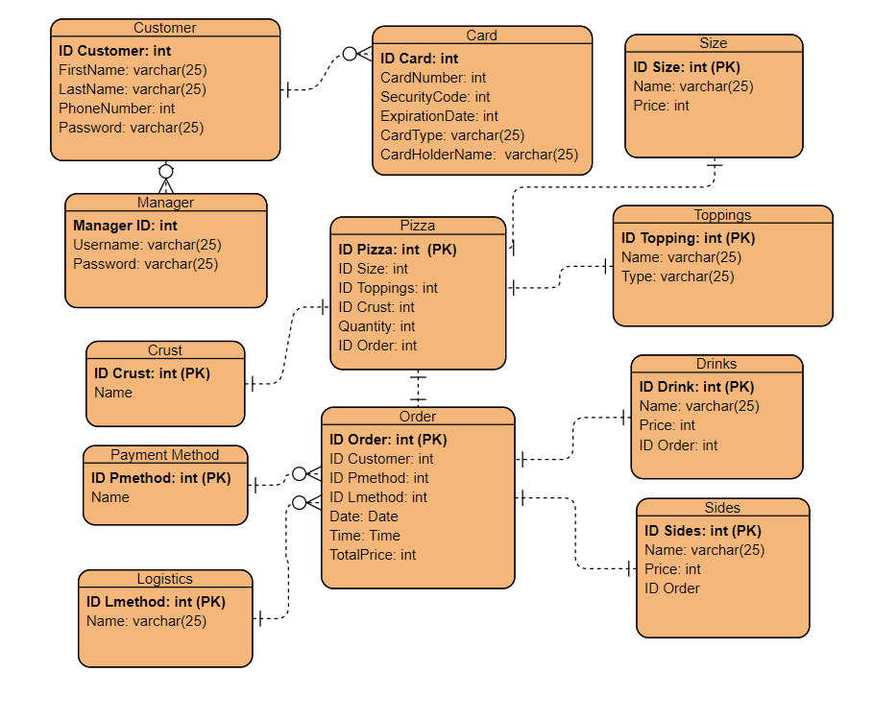
Entity Relationship Diagram

Slide 35
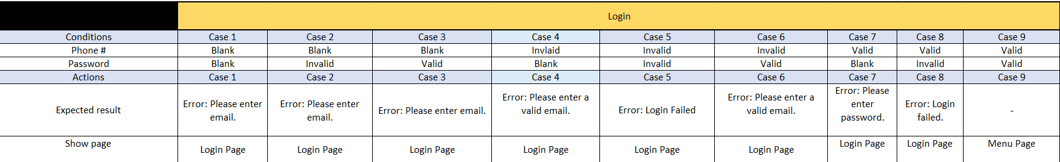
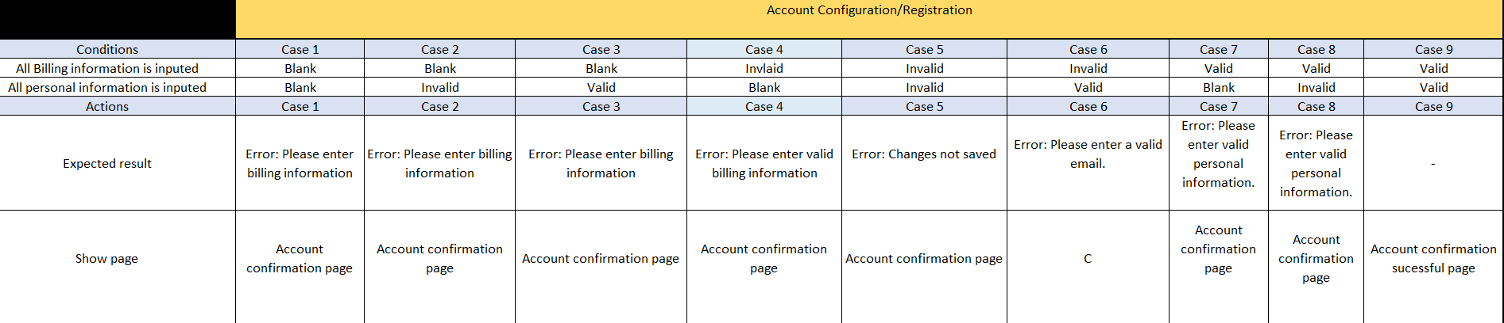
Decision Tables

Slide 36
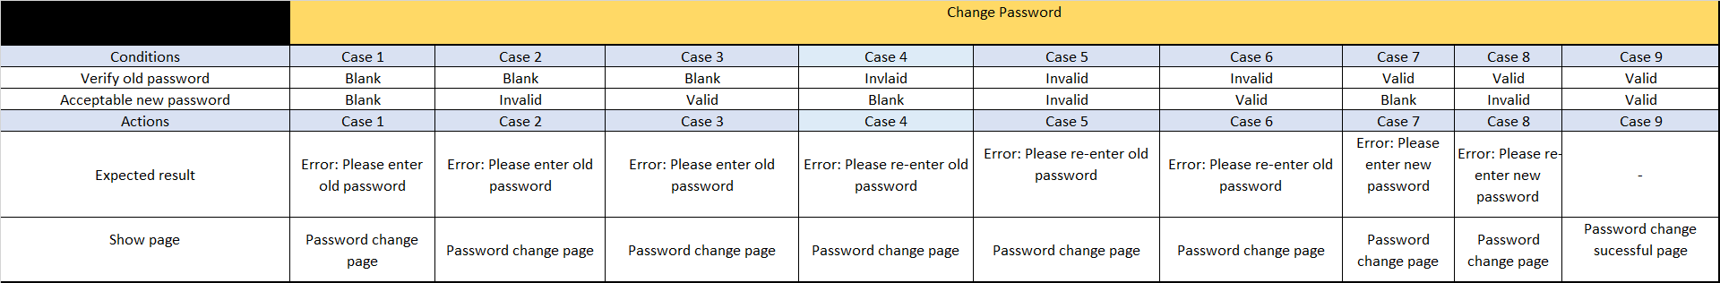
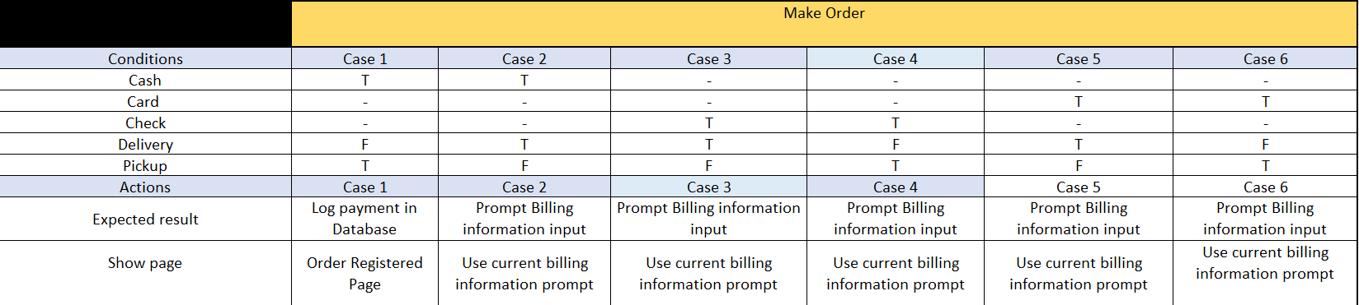
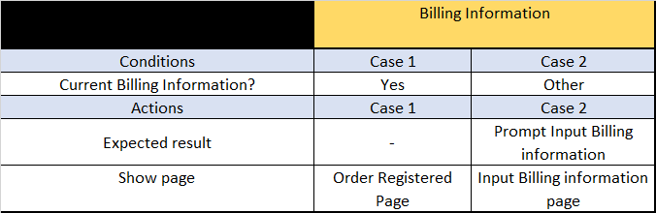

Slide 37
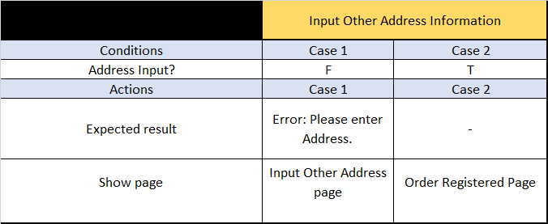
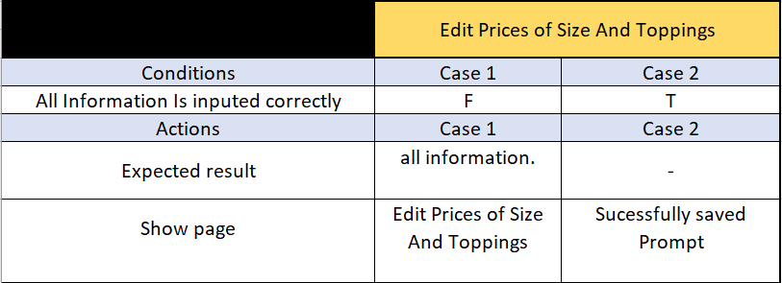
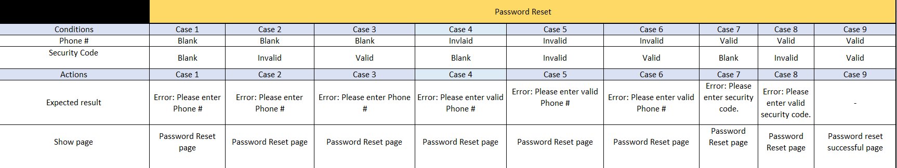

Slide 38
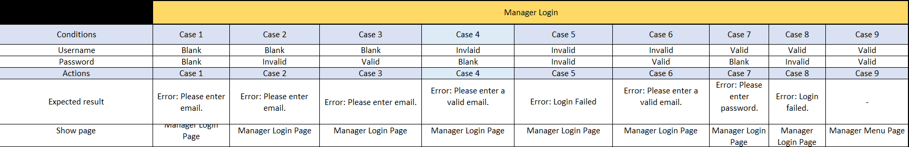
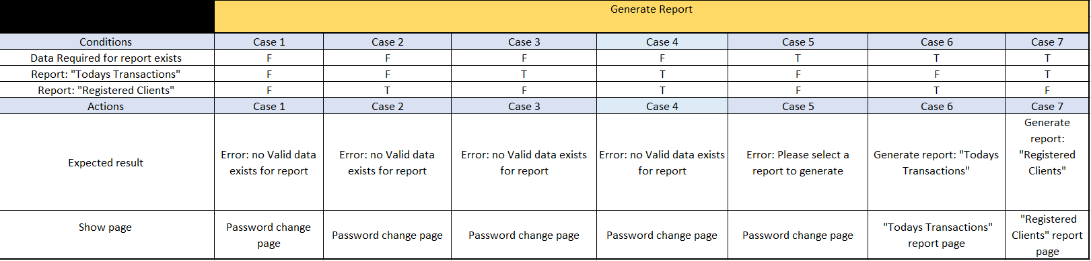
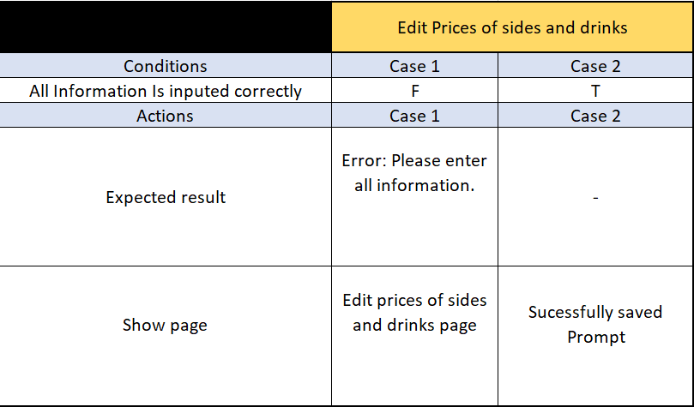

Slide 39
System Design Document
Report Formats
Screen Layouts/Shots
Detailed Class Diagrams and Supporting Text
Database Descriptions

Slide 40
Report Formats: Customer’s Receipt
MOM & POPS PIZZA RESTAURANT
ATLANTA, GA
SALE
12/4/2019 2:13 PM
Client Name:
Phone number:
Address:
Payment Method: Card
Logistics:
2 Thin Large Pizza --------------------------- $16.00
1 Pan Small Pizza ---------------------------- $4.50
Subtotal 1: $20.50
2 Medium 7UP ------------------------------- $2
Subtotal 2: $2.00
____________________________________
Total: $22.50
Sign Here: __________________________

Slide 41
Slip for the Cook
2 Thin Large Pizza
1st Topping: Cheese
2nd Topping: Pepperoni
3rd Topping : Peppers
4th Topping: -----------

Slide 42
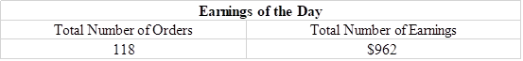
Earnings of the Day
Fields:
Total number of orders
Total number of Earnings

Slide 43
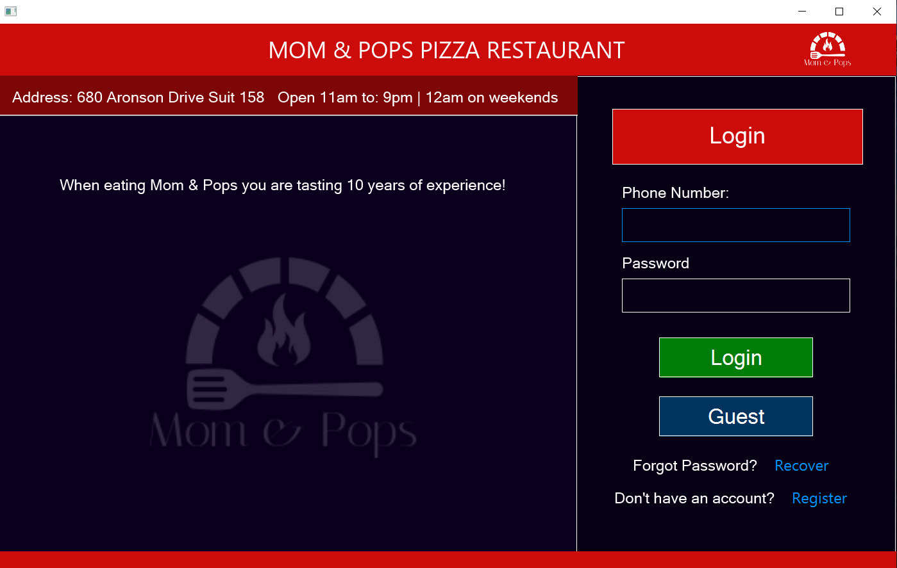
Screen Layouts/Shots Login:
The Login Screen fulfills the following system requirements:
“Customers can login as registered users and as guest users for those who don’t have an account.”
“A cashier can login as guest to take orders from clients calling the restaurant to order.”
The Login screen fulfills two separate required functionalities. Primarily its servers as a means login for returning customers. Secondarily it allows a cashier to login as a guest to ring up phone order.

Slide 44
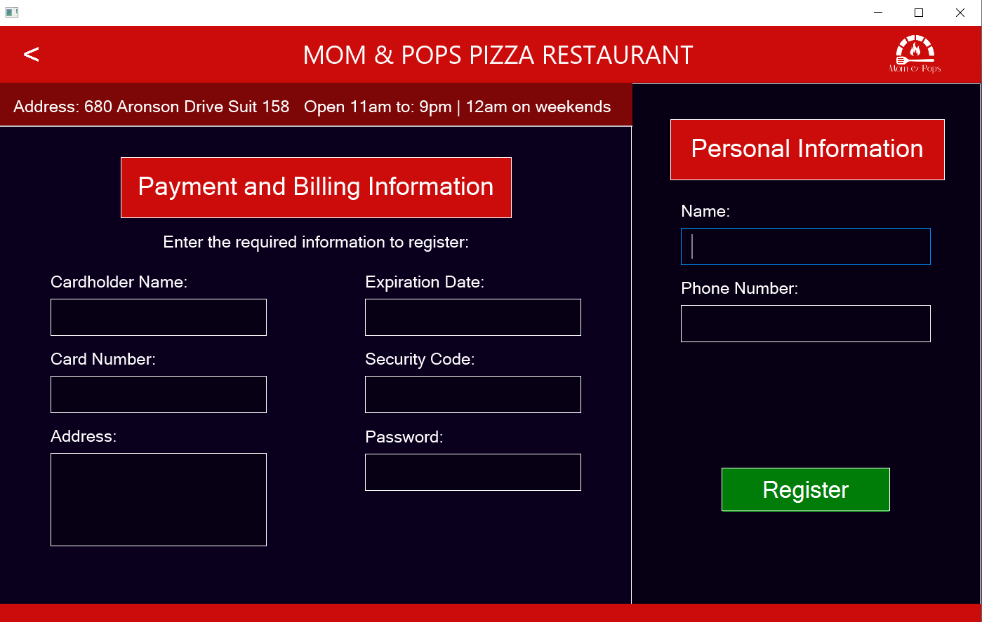
Registration:
The Registration screen fulfills the following system requirements:
Customers can create an account for the software.
This Screen allows the user to register an account with mom and pops pizza restaurant with the following information Cardholder name, Card Number, address, Expiration date, Security code, Password.

Slide 45
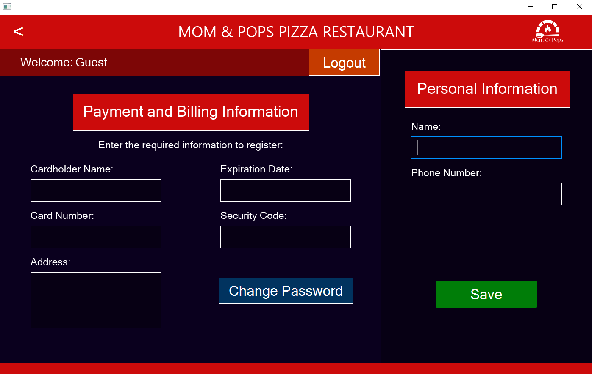
Account Configuration:
The Account Configuration Screen fulfills the following system requirements:
Registered customer can edit their personal and billing information and change and recover password.
This screen allows for the editing of account information for existing customers, for example any of the following fields; Cardholder name, Card Number, address, Expiration date, Security code, Password.

Slide 46
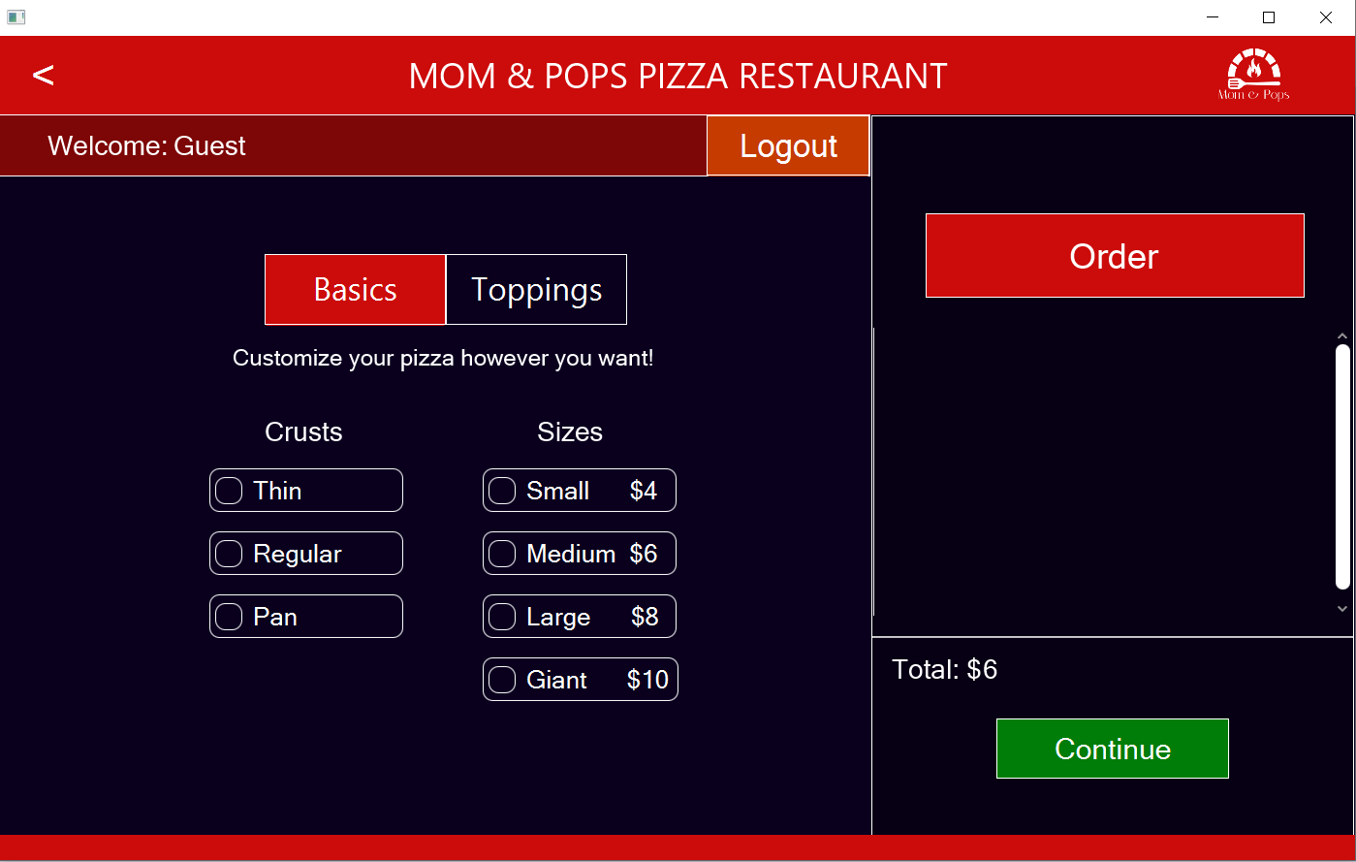
Basics:
The Basics fulfills the following system requirements:
Customers can fully customize the size, crusts, and toppings of the pizza.
In this screen the customer can select either “Thin”, “regular” or “pan” as well as choose a between the sizes, “small”, “medium”,” large” or “giant”. Through these options we fulfill the required capability to be able to select the size and crust type of the pizza.

Slide 47
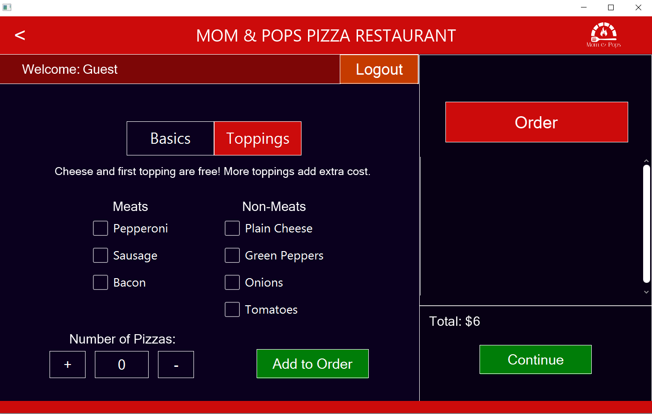
Toppings:
The Toppings Screen fulfills the following system requirements:
Customers can fully customize the size, crusts, and toppings of the pizza.
The price is based on the size of the pizza and the extra toppings.
The toppings screen fills the ability to customize between the meats “Pepperoni”, “Sausage” or “Bacon” and the non-meats “Plain Cheese”, “Green Peppers”, “Onions” or “Tomatoes”.

Slide 48
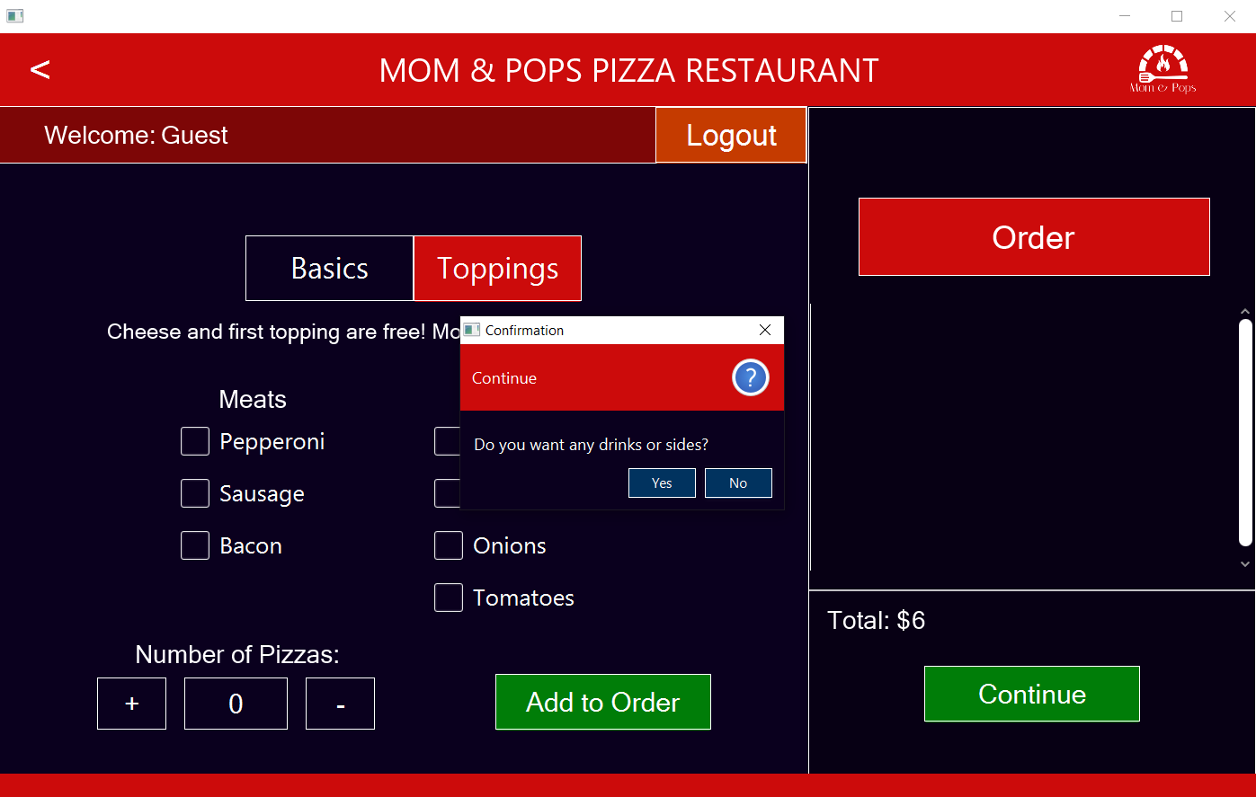
Drinks and Sides Prompt
The Drinks and Side Prompt fulfills the following system requirements:
The software’s interface should provide the users with useful shortcuts to improve the task finishing time.
The Drinks and Sides Prompt fulfills the ease of navigation requirement by allowing the user to flow directly to the order confirmation if no sides or drinks are needed.

Slide 49
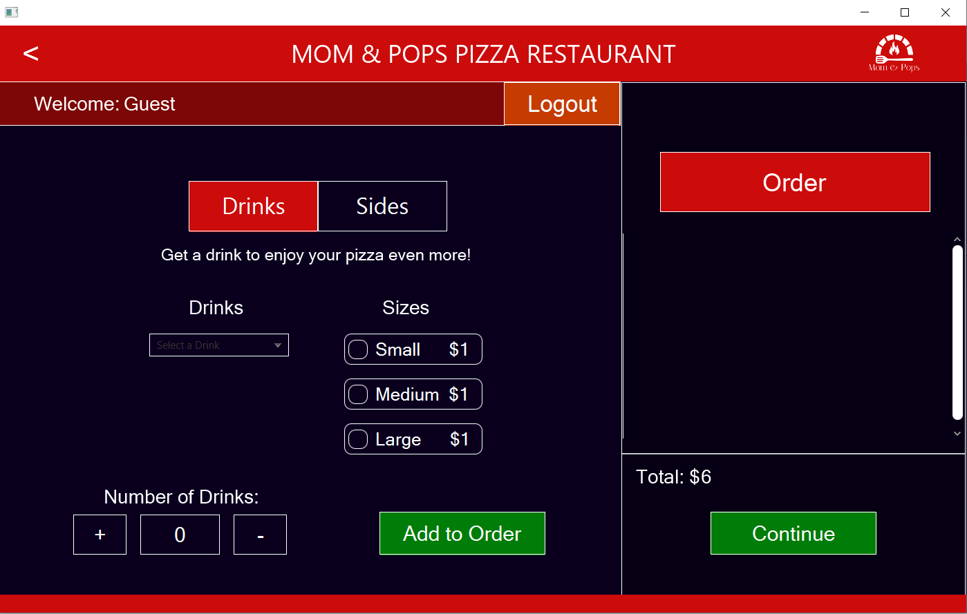
Drinks:
The Drinks Screen fulfills the following system requirements:
After adding the pizzas to the order, customer can choose to go to the drinks and sides screen or go directly to the order confirmation screen
The Drinks screen provides the following drink options “Small”, “Medium” or “Large” to be added to the cart.

Slide 50
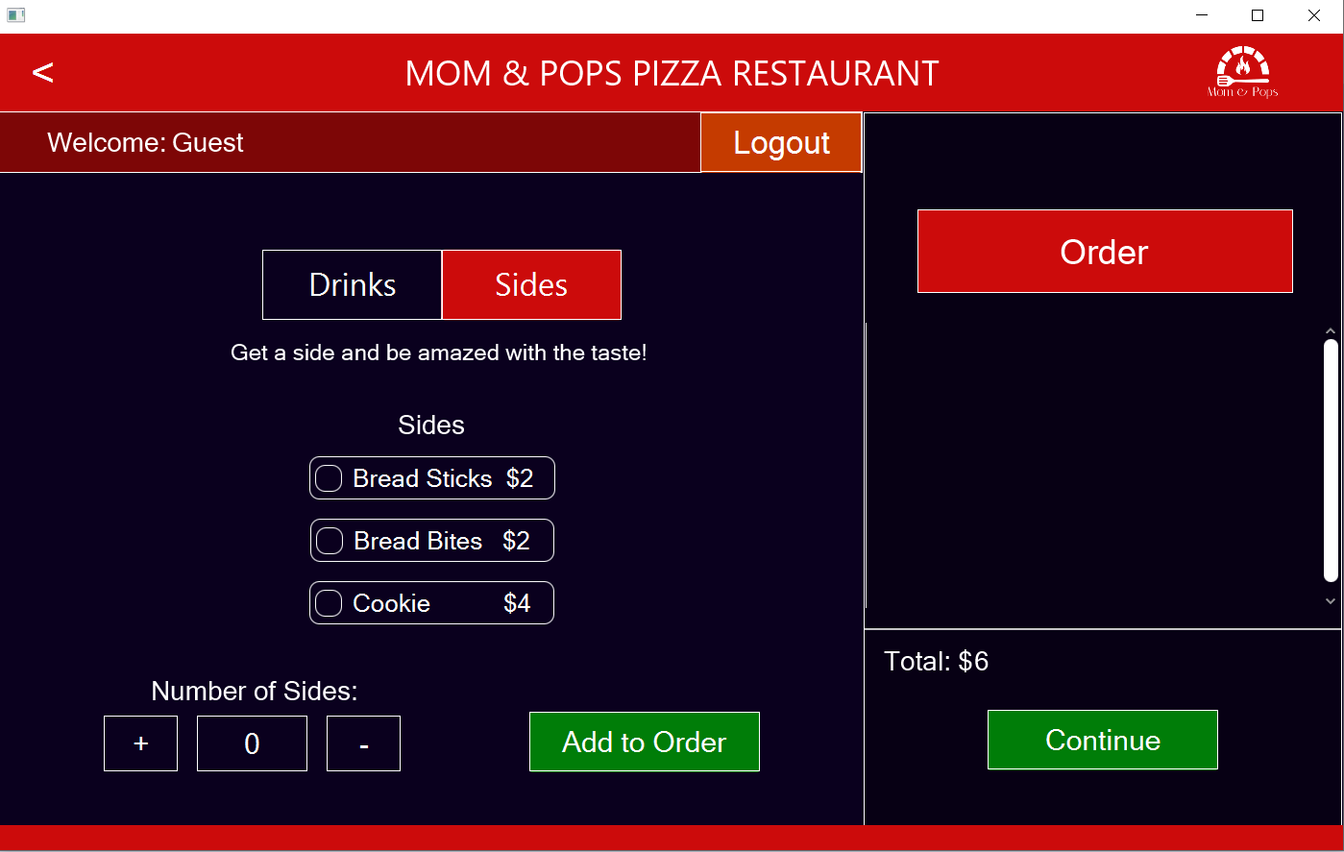
Sides
The Sides Screen fulfills the following system requirements:
After adding the pizzas to the order, customer can choose to go to the drinks and sides screen or go directly to the order confirmation screen
The Sides screen allows the user to choose between the following sides “Bread Sticks”, “Bread Bites” or “Cookie” and add the following to the order.

Slide 51
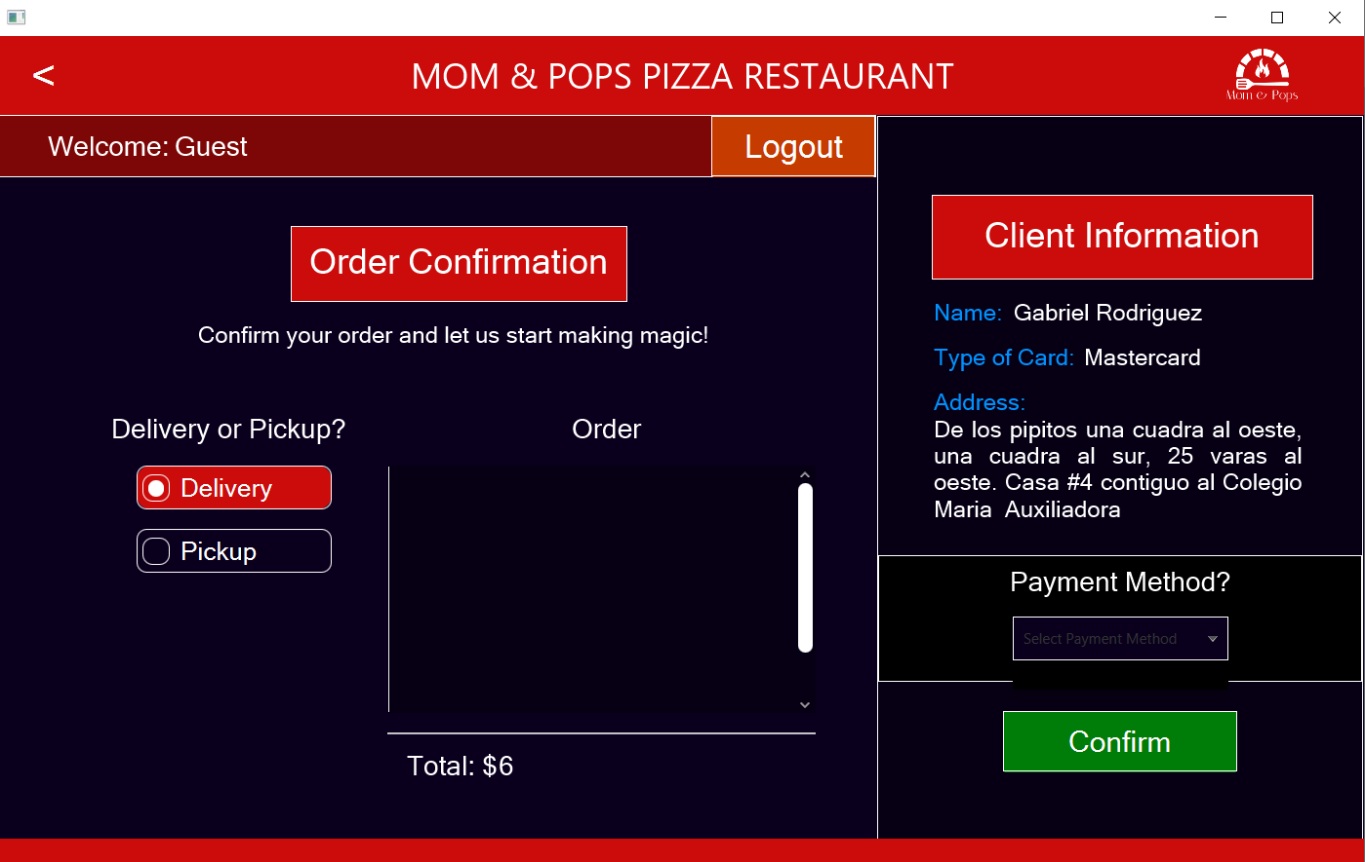
Order Confirmation
The Order Confirmation Screen fulfills the following system requirements:
When finishing all customization of pizzas, drinks or sides, the customer will be able to review their order in the account confirmation screen. There they will select the payment method and the logistics of the order (Delivery or Pickup). There’s no dining at the restaurant. The system must have three different payment methods: Cash, Card, and Check.
The Order confirmation screen allows the user to review their itemized order and to select either “delivery or “pickup” as well as to choose between three payment options;” cash”, “card”, or a “check”.

Slide 52
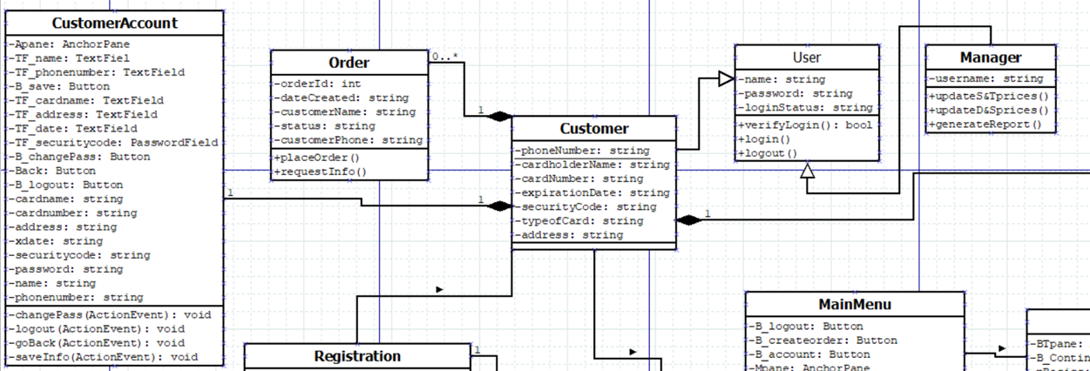
Detailed Class Diagrams

Slide 53
User Class:
Contains all general information of the user entities that can be either the manager or the customer. It’s an abstract class and is the parent of the Customer and Manager Class.
The method Verify Login does a query on the database to see if the data is valid for login.
The method Login gets the information of the user and goes to the main menu.
The method Logout remove all current information and goes to the first login page.
Customer Class: Contains all specific information of the client like phone number, name, card information, etc. This class is a child of the User Class. Without the customer class’ information there can’t be an order, or customer account or order confirmation class. Also, an order, customer account, or order confirmation can only have 1 customer, while the customer can have only one customer account, but many orders and order confirmations.
Manager Class: Contains all specific information of the manager which is just the username. This class is a child of the User Class.
The method UpdateS&TPrices updates the price information on sizes and toppings.
The method UpdateD&SPrices updates the price information on drinks and sides.
The method generate report will create a report with the current selection of data.
Order Class: Contains all information that an order needs except for the items acquired as those will take place in the Order Confirmation Class.
The method Request Information prompts the user for personal or billing information to complete the order if needed.
The method Place Order registers the transaction in the database.
Customer Account Class: Contains all the information of the customers to enable them to edit their data. It controls all the objects that appear in the view of the Account Configuration Screen.
The method Change Pass updates the new password of the user in the database.
The method Save Info updates the new personal and billing information of the user in the database.

Slide 54
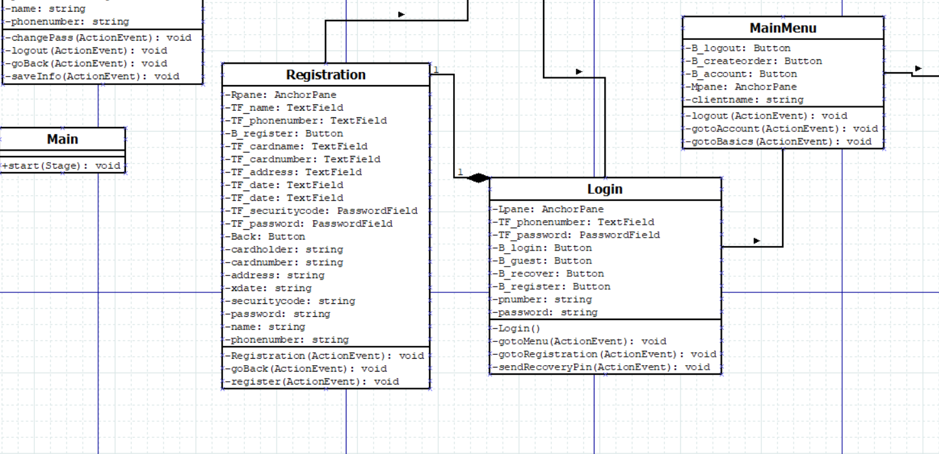

Slide 55
Registration Class: Requests all the information of the customers to enable them to register. It controls all the objects that appear in the view of the Registration Screen.
The method Register validates that the inputted data is correct and if it is, registers the information in the database.
Login Class: Requests the information needed for a user to login to his or her account. The information requested is phone number and password, if they are already registered. This class also controls the view of all the objects in the Login screen. There can’t be a registration class without the login class because to get to the registration class you must go through the login class.
The method Login validates the phone number and password inputted and, if it is correct, gets the information of the user and transitions to the main menu screen.
The method gotoRegistration transitions the user to the registration screen.
The method sendRecoveryPin opens the prompt to recover the password.
Main Menu Class: Controls all the object of the Main Menu Screen.
The method gotoAccount transitions the user to the Account Configuration Screen.
The method gotoBasics transitions the user to the BTmenu.

Slide 56
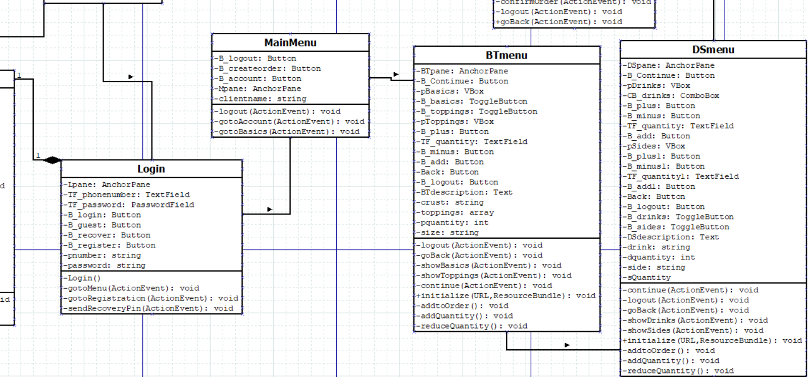
BTmenu Class: Controls all the objects of the Basics and Toppings Screen. It has methods for returning to the previous screen, traverse the controls to select and customize the pizza, for adding to the order the desire amount and continue the process of order taking.
DSmenu Class: Controls all the objects of the Drinks and Sides Screen. It has methods for returning to the previous screen, traverse the controls to select the type of drink and sides the user wants, for adding to the order the desire amount of drinks or sides and to continue to the Order Confirmation String.

Slide 57
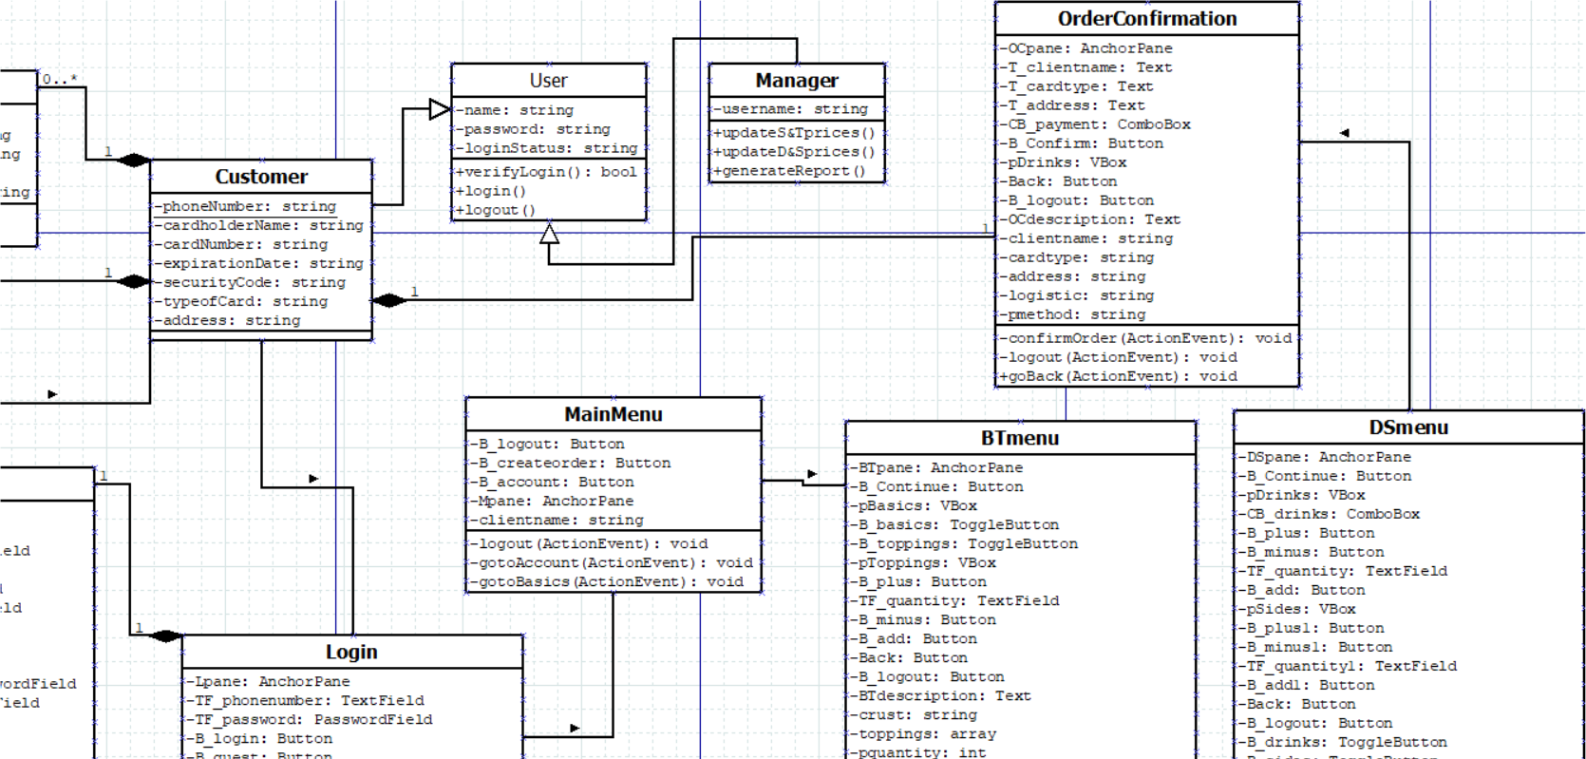
Order Confirmation Class: Contains all the final information of the order, the user, and the logistic and payment method. Also, controls all the object of the Order Confirmation Screen with methods for returning to the previous page, selecting the payment method, selecting the logistic method (delivery or pickup), removing anything from the order, or continuing with the final payment of the order.
All the classes containing menu are associated with each other because they manage related information.
The Customer Class is associated with the login, registration, customer account, order, and order confirmation classes.
The Main Class: Just initializes the first view which is the Login Class.

Slide 58
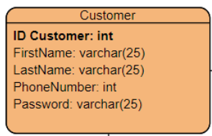
Database Table Descriptions Customers
Fields:
Customer ID (Primary Key) – is the field that is unique to each customer. It is created to differentiate one customer from another.
First Name – This field stores the first name of each customer that signs up for a user account. The information is stored in the database.
Last Name – This field stores the last name of each customer that signs up for a user account in the system.
Phone Number – This field stores the phone number of each customer in the system
Password – When a customer makes an account, they must create a password for the account, and it is stored in the password field.
Address – This field saves the home, apartment, office, etc. address of the registered customer.

Slide 59
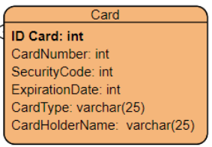
Card – Stores the credit/debit card information of the registered customers.
Fields:
Card ID (Primary Key) – is the field that is unique to each card and is made to differentiate one card from another.
Card Number – this holds the 16-digit code combination that comes with all credit/debit cards.
Security Code – holds the 3-digit security code that comes on the back of each credit/debit card.
Expiration Date – lists the expiration date that comes with each credit/debit card the date involves the year and month.
Card Type – this stores what type of credit/debit card the customer is using for example it could be a Mastercard or a Visa.
Card Holder Name – this field saves the name written on the credit/debit card.

Slide 60
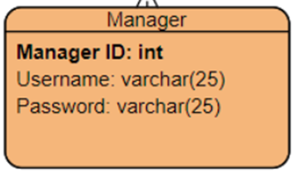
Manager – this table holds the information of the managers username and passwords they need to create to access the system.
Fields:
Manager ID (Primary Key) – is the field that is unique to the manager which is necessary to distinguish one manager from another.
Username – this is the field that stores the usernames of the managers.
Password – this stores the passwords of the managers.

Slide 61
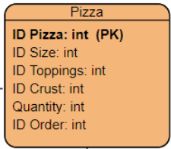
Pizza – this table helps store the information of the pizzas
Fields:
Pizza ID (Primary Key) – this field is unique to tell the difference between pizzas.
Size ID – this field links to the table Size primary key as they are connected to help with the size of the pizzas.
Topping ID – this field links to the Topping table primary key which helps tell the pizza toppings
Crust ID – this field links to the Crust table, to tell what type of crust is on the pizza.
Quantity – this field tells the amount of pizzas being ordered.
Order ID – this field links to the Order table which holds the information of the pizza order.

Slide 62
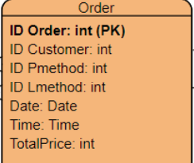
Order – this table holds the customer’s order information.
Fields:
Order ID (Primary Key) – this field is unique so that the database system can tell the difference between orders because some orders might come out the same.
Customer ID – this field links to the Customer table
Pmethod ID – this field links to the Payment Method table.
Lmethod ID – this field links to the Logistics table
Date – this field stores the date of the order.
Time – this field stores the time of the table.
Total Price – this field holds the total price of the customer’s order.

Slide 63
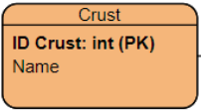
Table: Crust – this table holds the crust types available in Mom & Pop’s pizza restaurant
Fields:
Crust ID (Primary Key) – field is unique and necessary for the table.
Name – stores the names of the crusts available for the pizzas which are thin, regular, and pan.

Slide 64
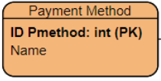
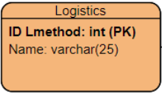
Table: Payment Method – this table stores the payment method process
Fields:
Pmethod ID (Primary Key) – this field is unique and helps differentiate the payment methods.
Name – this holds the different payment methods, cash, credit/debit card and checks
Table: Logistics – this table runs the data of the system
Fields:
Lmethod ID (Primary Key) – this field is unique and necessary for the table.
Name – this field holds the names of the logistics of the table.

Slide 65
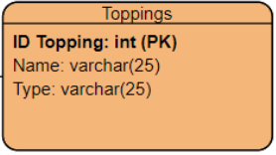
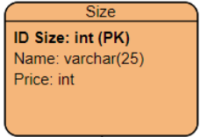
Table: Size – this table holds the different sizes of the pizza.
Fields:
Size ID (Primary Key) – this field is unique and tells the different sizes.
Name – this field holds the name of the sizes like small, medium, large, extra-large.
Price – this field holds the price of the different sizes of pizza.
Table: Toppings – this table stores the pizza toppings
Fields:
Topping ID (Primary Key) – this field is unique and tells the difference between toppings.
Name – this field holds the names of the toppings for example peperoni, cheese, etc.
Type – this field holds the different type of toppings like meats and non-meats.

Slide 66
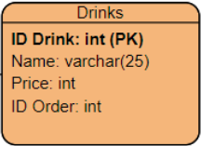
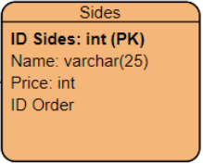
Table: Drinks – this table holds the different drink options available.
Fields:
Drink ID (Primary Key) – this field is unique and tells the difference between drinks.
Name – this field holds the name of the drinks.
Price – this field holds the price of the drinks.
Order ID – this field links to the Order table.
Table: Sides – this table holds the different menu option sides available at the restaurant.
Fields:
Sides ID (Primary Key) – this field is unique to the table and it differentiates the sides from one another.
Name – this field holds the name of the sides available
Price – this field names the price of the sides.
Order ID – this field links to the Order table.

